Slide 1

Region 1 Training Workshop
Crowne Plaza Albany – 1-2 August 2008
Session 3B
Meeting Leadership
Harold Belson
Northeastern Area Chair
Region 1

Slide 2

 | Survey
 | Prior Leadership Workshop Attendance
 | Previously attended Meeting Leadership by Belson
 | IEEE Leadership Position
 | First Time Section Chair
 | First Time Vice Chair and not previously a Chair
 | First Time Secretary or Treasurer and not previously a Chair or Vice Chair
 | First Time Committee Chair and not previously any of the above
 | None of the above
 | Meeting Conduct Frequency
 | Regularly conducts 6 or more meetings per year with
 | More than 20 attendees
 | More than 10 attendees
 | More than 5 attendees
 | Meeting Conduct Longevity
 | <2 years
 | >2 and <5 years
 | > 5 years

Slide 3

Have a written agenda that includes:
Meeting Title and Date
Meeting Goals:
Business Meeting Agenda
Approve agenda
Secretary’s Report (identify each person with action by name)
Treasurer’s Report
Special and Committee Chair Reports
Old Business
New Business
Summary of action items and review of meeting goals
Future Meeting Dates including next three meetings

Slide 4
Manage your meeting and assert leadership
Learn when to Listen, Speak and Shut off discussion that wanders. Give your team latitude to express feelings, but manage your meeting and keep it moving. It is easy for a meeting to go on too long.
Follow Roberts Rules of Order. More formality is required for larger size meetings.
Start you meeting on time. Starting late consistently conveys a message to arrive later yet for the next meeting.
Assign action items to specific individuals.
Commit action items to writing as soon as possible following a meeting so all involved, both present and absent, know who has what action.

Slide 5
Communicate personally with your team Members
Consider a phone call or a personal note to each person elaborating on their action items and make it precisely clear what is required and when.
Convey your appreciation for completed actions.
Train your team. Tell members individually what you would like them to do differently. Tell members when their actions are counter productive or disruptive and offer suggestions on how they might have handled an issue differently.

Slide 6

Extracted from
Making Committees Work by Carl Selinger
June 2006 SPECTRUM
Carl Selinger’s context is focused on how to get things done – and enhance your career.
Treat committee work as real work
  Set agendas and follow them
  Get people to accept responsibility for tasks and hold them accountable
  Follow-up is crucial
  Promulgate action items to all so everyone gets the word.
The chair should manage
  Manage and lead and delegate the work.
Treat committees like teams
  Make sure everyone understands the big picture
  Identify a role for each person. Divvy up the tasks so everyone has meaningful work.
  Write thank you notes regularly

Slide 7
Making Committees Work by Carl Selinger
Assert good Leadership
Get active members
  Go up to people at professional society meetings and ask if they want to be involved.
  I personally am constantly on the look-out for new members.
Get rid of deadwood
  Ask unproductive or no-show members to resign. Consider these words:
  “You must be very busy these days, as you haven’t been able to attend recent meetings or do what you said you would do, so I’ll understand if you don’t have the time to participate in the committee.”
  Pick the right words. Do not ask them if they want to stay on the committee, because they will feel guilty and say yes, which solves nothing.
Informally identify future leaders.
  Talk to the future leaders and determine their future interest
  Do succession planning.
  Get the good guys in positions of responsibility

Slide 8
Ideas to Consider
A large portion of a meeting is spent giving reports. They contribute to a common knowledge base, but generally do not result in productivity.
  Attempt to obtain and distribute reports in writing prior to a meeting and minimize their discussion.
  Note the Region meeting process and the use of a consent agenda.
Develop skills in addressing a committee item by e-mail with players responding to all with comment.
  Attempt to vote and bring the issues to conclusion exclusively by email.
Conduct occasional meetings completely by email.
  Meetings are expensive.
  A typical EXECOM meeting involves 12 people for about 2 hours plus 1 hour travel.
  At $100 per man-hour, the meeting cost is $3,600.

Slide 9
Pushy Manager
Case Study
There is a manager in my division. When discussion begins in meetings, she shoots questions at the person who has the floor before he or she is done speaking and summarizing. She talks over people and does not stop.
I have at times continued to talk while she talks over me, and it does not stop her. I know that she is not deaf, nor is she ignorant. Her perspective is the only one that I hear at the end of meetings and it is frustrating. She brings up isolated issues with such fervor that people will come away thinking an issue is of global importance when it is not, These meetings turn combative and confrontational rather than what they are meant to be, which is informative.

Slide 10

Leadership
Leadership is the art of getting someone else to do something that you want done because he/she wants to do it.
In a business meeting this is done by competently exercising the standard leadership role in calling and running meetings.

Slide 11
Meetings have Personalities
Negative factors
Fragile and affected by seemingly small things
Chair is late
Chair appears unprepared
Participants arrive late
Participants demonstrate they are not ready by fumbling their way through
Positive factors
If doubts about attendance, check in advance and consider canceling beforehand if appropriate
Chair arrive beforehand and be ready for work
Call to Order at appointed time whether all there or not
Proceed with the meeting as latecomers arrive. Keep the meeting rolling.
Give a clear indication that the agenda will be followed and that the meeting will finish at the specified time.

Slide 12
Leadership Cautions
Control can be subtle.
Leader resents a question and shows it! Questions, even unwanted ones should be encouraged and handled.
Leader gets into discussion and monopolizes it.
Leader put a participant down, especially with a personal remark.
Leader permits an argument between two participants.
Leader looks confused, unprepared or unknowledgeable.

Slide 13
Meeting Importance
The meeting is management’s most important tool of communications.
Good, bad and unnecessary meetings.
Is the meeting necessary? Purpose? Right time? What will happen if I don’t call the meeting? What are my alternatives? How much will this meeting cost?

Slide 14
Causes of Bad Meetings
Too many meetings.
Meetings too long.
Meeting agendas contain too much.
Meetings compete with other meetings.
Too many people at meetings.
Wrong people at meetings.
Needed people not at meetings.
Meetings poorly planned.
Meetings called for weak reasons.
Poor chairmanship.
Meetings end without a conclusion.
Participants unprepared.

Slide 15
References
Making Committees Work by Carl Selinger
June 2006 SPECTRUM
Extracted from How to Run Better Business Meetings
A Reference Guide for Managers
The 3M Management Team
McGraw Hill, Copyright 1979
Becoming a Conflict Competent Leader
How You and Your Organization Can Manage a Conflict Effectively
Craig Runde and Tim Flanagan
A Joint Publication of the Jossey-Bass Business Management Series
and the Center for Creative Leadership
John Wiley & Sons, Copyright 2007

Slide 16
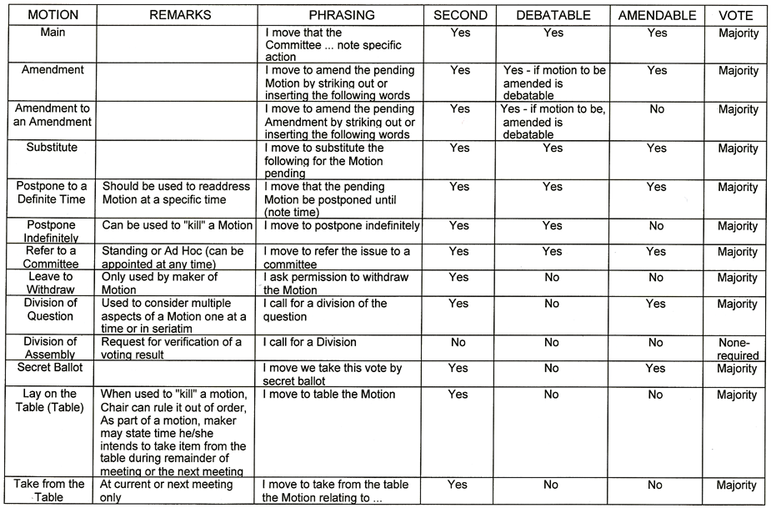
BASIC ROBERTS RULES OF ORDER

Slide 17
Contact Information
Author: Harold B. Belson
Email: h.belson@ieee.org

Slide 18
End

